Slide 1
SOA
Statement of Account

Slide 2
Process of Statement of Account
Call flow – Script
Opening Script - Welcome to Grihum Housing Finance Limited. My name is (Agent Name) How may I assist you?
Customer Concern - I need Statement of Account for my loan
AI - Please note that this call is being recorded for quality assurance and training purposes.
AI - To verify the information, kindly provide the registered mobile number.
Verification - Any 3 of the below verification questions needs to be answered (Information to be retrieved from Finnone and CRM – Screen shots shared from Slide 3 onwards)
Name/Date of Birth/Registered Email ID/Loan Sanction Amount/EMI Amount
AI - Thankyou Sir/Madam, your verification is completed. As I understand that you need statement of Account for your Home Loan
AI - We will raise the request for Statement of Account & also share the Statement of Account on your registered mail ID . Please confirm whether your Email ID is registered with us.
If yes – Thank you Sir!,
If NO – In that case Sir/Ma’am we will raise an Email ID updation request first . Once your Email ID is successfully registered with us, we request you to call us back after 3 working days to raise a fresh request for SOA
AI - (The SOA request will be raised in CRM , screenshots shared from Slide – 5)
AI - Any other details required apart from this?
Thankyou for calling Grihum Housing Finance Limited. Have a pleasant day!

Slide 3
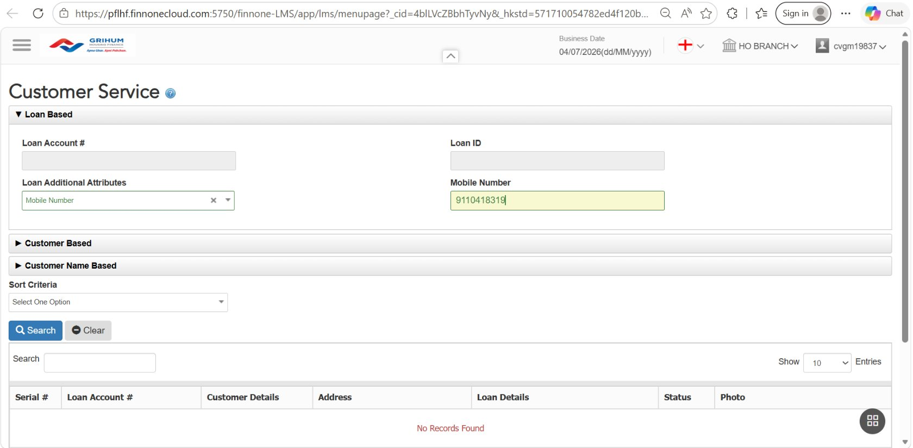
FINONE
VERFICATION TOUCHPOINT
To verify the information, please provide the customer's registered mobile number.

Slide 4
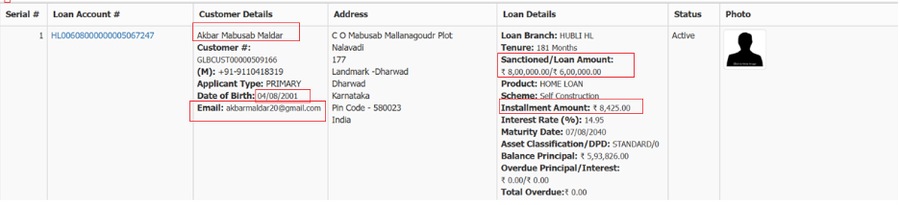
Verification - Any 3 of the below verification questions needs to be answered
VERFICATION TOUCHPOINT

Slide 5
CSR TAGGING
A.I activity - Raise Service request on call /post call – as feasible

Slide 6
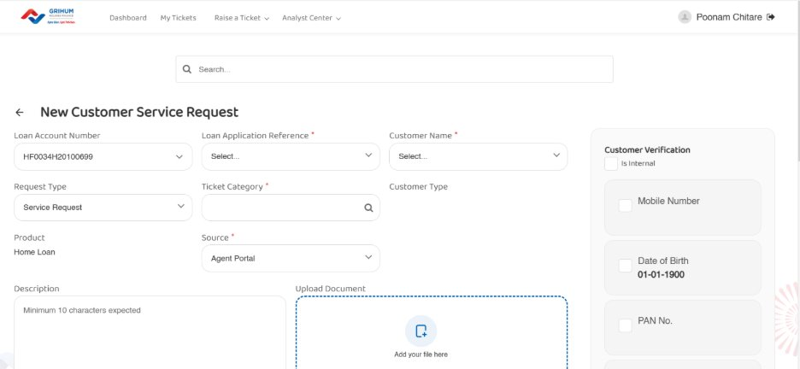
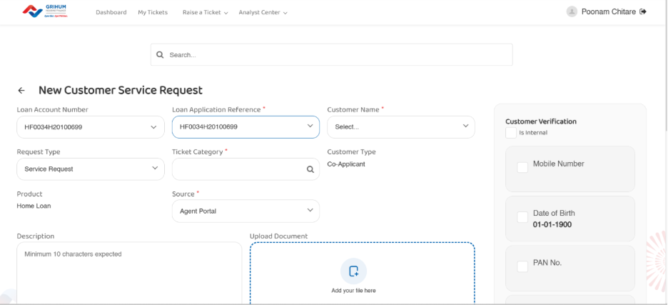
A.I activity - Raise Service request on call /post call – as feasible

Slide 7
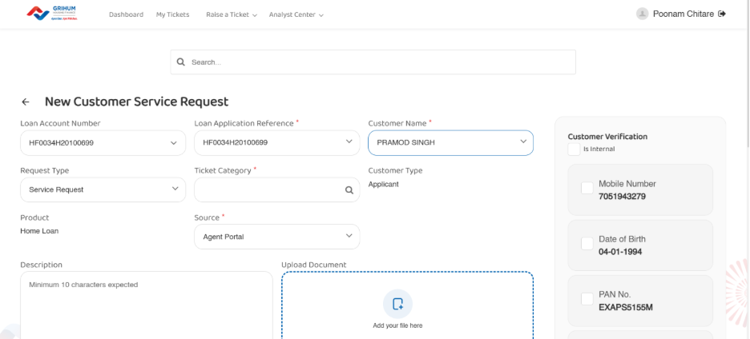
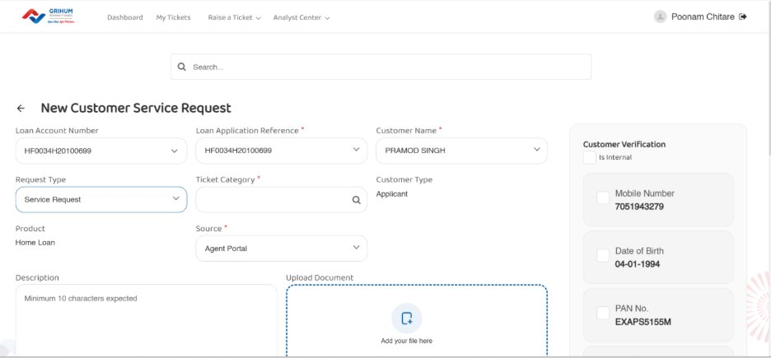
A.I activity - Raise Service request on call /post call – as feasible

Slide 8
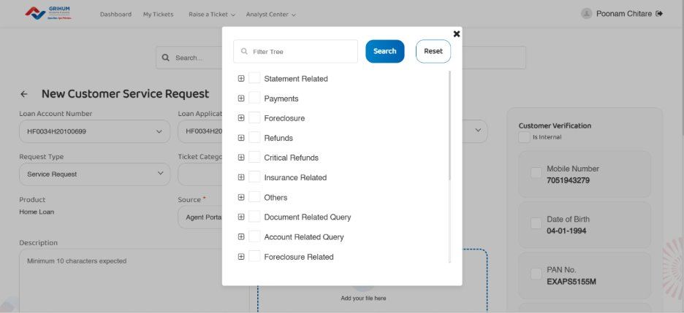
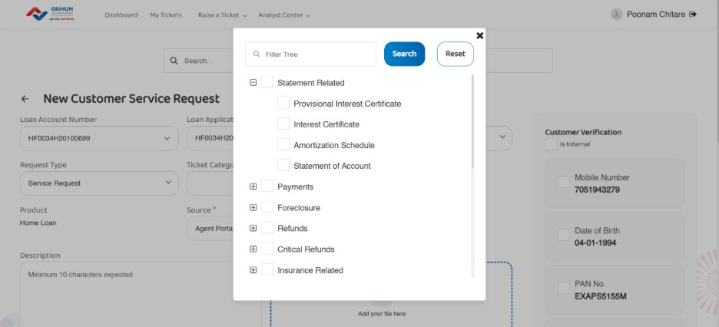
A.I activity - Raise Service request on call /post call – as feasible

Slide 9
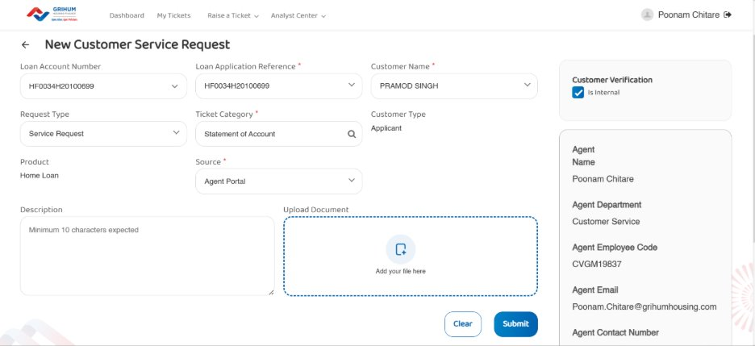
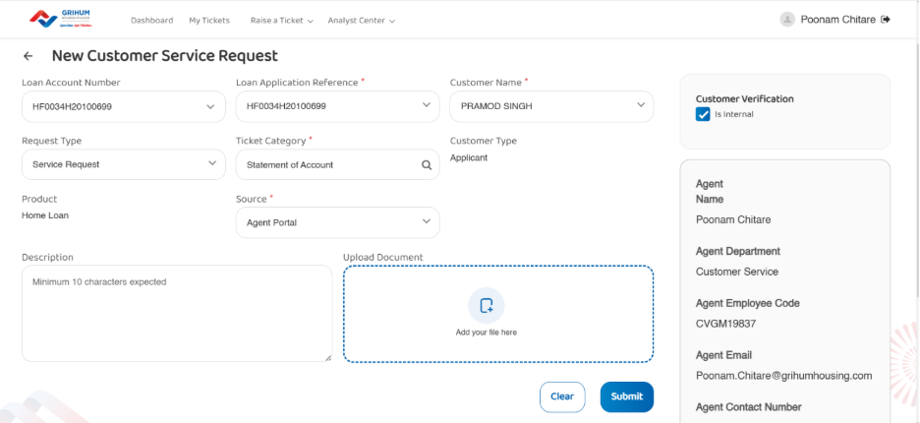
A.I activity - Raise Service request on call /post call – as feasible

